Slide 1
Lesson 2:
Introduction to Java Programming

Slide 2
Java is −
Object Oriented − In Java, everything is an Object. Java can be easily extended since it is based on the Object model.
Platform Independent − Unlike many other programming languages including C and C++, when Java is compiled, it is not compiled into platform specific machine, rather into platform independent byte code. This byte code is distributed over the web and interpreted by the Virtual Machine (JVM) on whichever platform it is being run on.
Simple − Java is designed to be easy to learn. If you understand the basic concept of OOP Java, it would be easy to master.
Secure − With Java's secure feature it enables to develop virus-free, tamper-free systems. Authentication techniques are based on public-key encryption.
Architecture-neutral − Java compiler generates an architecture-neutral object file format, which makes the compiled code executable on many processors, with the presence of Java runtime system.

Slide 3
Portable − Being architecture-neutral and having no implementation dependent aspects of the specification makes Java portable. Compiler in Java is written in ANSI C with a clean portability boundary, which is a POSIX subset.
Robust − Java makes an effort to eliminate error prone situations by emphasizing mainly on compile time error checking and runtime checking.
Multithreaded − With Java's multithreaded feature it is possible to write programs that can perform many tasks simultaneously. This design feature allows the developers to construct interactive applications that can run smoothly.
Interpreted − Java byte code is translated on the fly to native machine instructions and is not stored anywhere. The development process is more rapid and analytical since the linking is an incremental and light-weight process.
High Performance − With the use of Just-In-Time compilers, Java enables high performance.
Distributed − Java is designed for the distributed environment of the internet.
Dynamic − Java is considered to be more dynamic than C or C++ since it is designed to adapt to an evolving environment. Java programs can carry extensive amount of run-time information that can be used to verify and resolve accesses to objects on run-time.

Slide 4
History
Java is used in internet programming, mobile devices, games, e-business solutions, etc. There are given significant points that describe the history of Java.
1) James Gosling, Mike Sheridan, and Patrick Naughton initiated the Java language project in June 1991. The small team of sun engineers called Green Team.
2) Initially designed for small, embedded systems in electronic appliances like set-top boxes.
3) Firstly, it was called "Greentalk" by James Gosling, and the file extension was .gt.
4) After that, it was called Oak and was developed as a part of the Green project.
Why Java named "Oak"?
5) Why Oak? Oak is a symbol of strength and chosen as a national tree of many countries like the U.S.A., France, Germany, Romania, etc.
6) In 1995, Oak was renamed as "Java" because it was already a trademark by Oak Technologies.

Slide 5
Why Java Programming named "Java"?
7) Why had they chosen java name for Java language? The team gathered to choose a new name. The suggested words were "dynamic", "revolutionary", "Silk", "jolt", "DNA", etc. They wanted something that reflected the essence of the technology: revolutionary, dynamic, lively, cool, unique, and easy to spell and fun to say.
According to James Gosling, "Java was one of the top choices along with Silk". Since Java was so unique, most of the team members preferred Java than other names.
8) Java is an island of Indonesia where the first coffee was produced (called java coffee). It is a kind of espresso bean. Java name was chosen by James Gosling while having coffee near his office.
9) Notice that Java is just a name, not an acronym.
10) Initially developed by James Gosling at Sun Microsystems (which is now a subsidiary of Oracle Corporation) and released in 1995.
11) In 1995, Time magazine called Java one of the Ten Best Products of 1995.

Slide 6
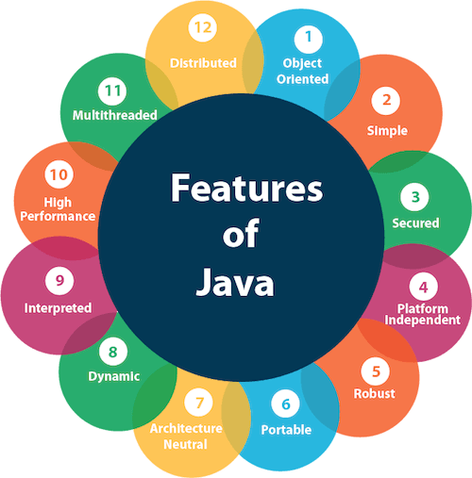
Features of Java
The primary objective of Java programming language creation was to make it portable, simple and secure programming language. Apart from this, there are also some excellent features which play an important role in the popularity of this language. The features of Java are also known as java buzzwords.

Slide 7
A Simple Java Program
Every Java program must have at least one class. Each class has a name. By convention, class names start with an uppercase letter.
In a program, multiple classes may cooperate with each other.
Each program needs an entry point to start execution.
The program is executed from the main method that is defined in one of the classes. A class may contain several methods. The main method is the entry point where the program begins execution.

Slide 8
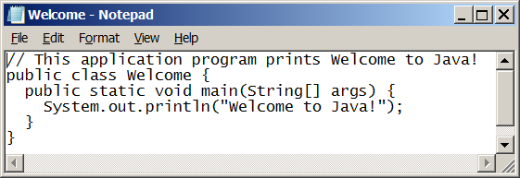
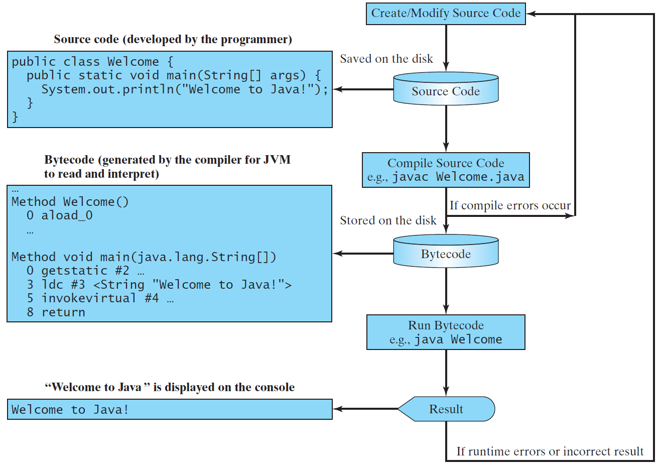
Creating, Compiling, and Running Programs

Slide 9
Compiling Java Source Code
The Java language is a high-level language, but Java bytecode is a low-level language. The bytecode is similar to machine instructions but is architecture neutral and can run on any platform that has a Java Virtual Machine (JVM).
The virtual machine is a program that interprets Java bytecode. This is one of Java’s primary advantages: Java bytecode can run on a variety of hardware platforms and operating systems.
Java source code is compiled into Java bytecode (.class file) and Java bytecode is interpreted by the JVM. Your Java code may use the code in the Java library. To execute a Java program is to run the program’s bytecode.

Slide 10
Compiling Java Source Code
You can execute the bytecode on any platform with a JVM, which is an interpreter and resides in RAM. It translates the individual instructions in the bytecode into the target machine (i.e. the machine on which it is working at) language code one at a time rather than the whole program as a single unit.
Each step is executed immediately after it is translated.
The bytecode can then run on any computer with a Java Virtual Machine, as shown below. In fact, Java Virtual Machine is a software that interprets Java bytecode.

Slide 11
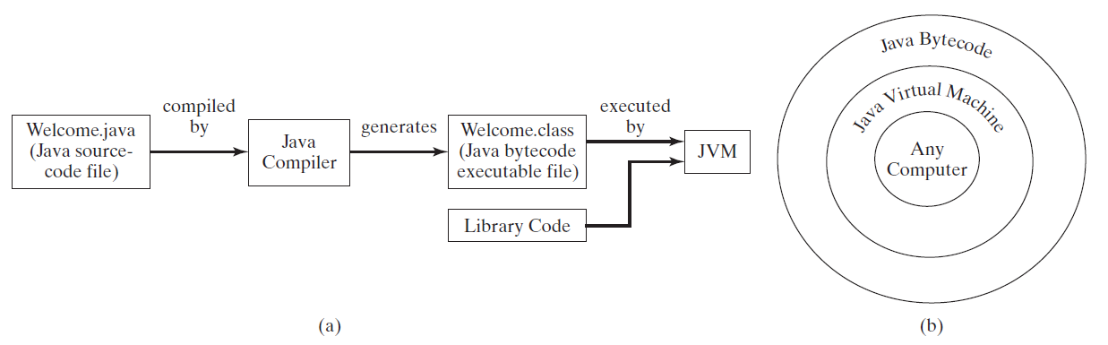
Compiling Java Source Code

Slide 12
Anatomy of a Java Program
Class name
Main method
Statements
Statement terminator
Reserved words
Comments
Blocks

Slide 13
Class Name
Every Java program must have at least one class. Each class has a name. By convention, class names start with an uppercase letter. In this example, the class name is Welcome.
// This program prints Welcome to Java!
public class Welcome {
public static void main(String[] args) {
System.out.println("Welcome to Java!");
}
}

Slide 14
Main Method
Line 2 defines the main method. In order to run a class, the class must contain a method named main. The program is executed from the main method.
// This program prints Welcome to Java!
public class Welcome {
public static void main(String[] args) {
System.out.println("Welcome to Java!");
}
}

Slide 15
Statement
A statement represents an action or a sequence of actions. The statement System.out.println("Welcome to Java!") in the program below is a statement to display the greeting "Welcome to Java!”.
// This program prints Welcome to Java!
public class Welcome {
public static void main(String[] args) {
System.out.println("Welcome to Java!");
}
}

Slide 16
Statement Terminator
Every statement in Java ends with a semicolon (;).
// This program prints Welcome to Java!
public class Welcome {
public static void main(String[] args) {
System.out.println("Welcome to Java!");
}
}

Slide 17
Reserved words
Reserved words or keywords are words that have a specific meaning to the compiler and cannot be used for other purposes in the program. For example, when the compiler sees the word class, it understands that the word after class is the name for the class.
// This program prints Welcome to Java!
public class Welcome {
public static void main(String[] args) {
System.out.println("Welcome to Java!");
}
}

Slide 18
Blocks
A pair of braces in a program forms a block that groups components of a program.

Slide 19
Special Symbols

Slide 20
Programming Errors
Syntax Errors
  Detected by the compiler
Runtime Errors
  Causes the program to abort
Logic Errors
  Produces incorrect result

Slide 21
Constants, Variables and Data types
A constant is an entity in programming that is immutable. In other words, the value that cannot be changed. In this section, we will learn about Java constant and how to declare a constant in Java.
What is constant?
Constant is a value that cannot be changed after assigning it. Java does not directly support the constants. There is an alternative way to define the constants in Java by using the non-access modifiers static and final.
How to declare constant in Java?
In Java, to declare any variable as constant, we use static and final modifiers. It is also known as non-access modifiers. According to the Java naming convention the identifier name must be in capital letters.
Static and Final Modifiers
The purpose to use the static modifier is to manage the memory.
It also allows the variable to be available without loading any instance of the class in which it is defined.
The final modifier represents that the value of the variable cannot be changed. It also makes the primitive data type immutable or unchangeable.

Slide 22
The syntax to declare a constant is as follows:
    static final datatype identifier_name=value;
For example, price is a variable that we want to make constant.
    static final double PRICE=432.78;
Where static and final are the non-access modifiers. The double is the data type and PRICE is the identifier name in which the value 432.78 is assigned.
In the above statement, the static modifier causes the variable to be available without an instance of its defining class being loaded and the final modifier makes the variable fixed.
Here a question arises that why we use both static and final modifiers to declare a constant?
If we declare a variable as static, all the objects of the class (in which constant is defined) will be able to access the variable and can be changed its value. To overcome this problem, we use the final modifier with a static modifier.
When the variable defined as final, the multiple instances of the same constant value will be created for every different object which is not desirable.
When we use static and final modifiers together, the variable remains static and can be initialized once. Therefore, to declare a variable as constant, we use both static and final modifiers. It shares a common memory location for all objects of its containing class.

Slide 23

ConstantExample1.java
  import java.util.Scanner;
  public class ConstantExample1
  {
  //declaring constant
  private static final double PRICE=234.90;
  public static void main(String[] args)
  {
  int unit;
  double total_bill;
  System.out.print("Enter the number of units you have used: ");
  Scanner sc=new Scanner(System.in);
  unit=sc.nextInt();
  total_bill=PRICE*unit;
  System.out.println("The total amount you have to deposit is: "+total_bill);
  } }

Slide 24
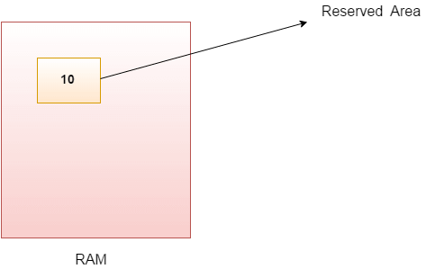
Java Variables
A variable is a container which holds the value while the Java program is executed. A variable is assigned with a data type.
Variable is a name of memory location. There are three types of variables in java: local, instance and static.
There are two types of data types in Java: primitive and non-primitive.
Variable
Variable is name of reserved area allocated in memory. In other words, it is a name of memory location. It is a combination of "vary + able" that means its value can be changed.
int data=50;//Here data is variable

Slide 25
Types of Variables
1) Local Variable:
A variable declared inside the body of the method is called local variable. You can use this variable only within that method and the other methods in the class aren't even aware that the variable exists.
A local variable cannot be defined with "static" keyword.
2) Instance Variable
A variable declared inside the class but outside the body of the method, is called instance variable. It is not declared as static.
It is called instance variable because its value is instance specific and is not shared among instances.
3) Static variable
A variable which is declared as static is called static variable. It cannot be local. You can create a single copy of static variable and share among all the instances of the class. Memory allocation for static variable happens only once when the class is loaded in the memory.

Slide 26
Example to understand the types of variables in java
  class A
  {
  int data=50;//instance variable
  static int m=100;//static variable
  void method()
  {
  int n=90;//local variable
  }
  }//end of class

Slide 27
Java Variable Example: Add Two Numbers
  class Simple
  {
  public static void main(String[] args)
  {
  int a=10;
  int b=10;
  int c=a+b;
  System.out.println(c);
  }
  }
Output:
20

Slide 28
Data Types in Java
Data types specify the different sizes and values that can be stored in the variable. There are two types of data types in Java:
Primitive data types: The primitive data types include boolean, char, byte, short, int, long, float and double.
Non-primitive data types: The non-primitive data types include Classes, Interfaces, and Arrays.

Slide 29
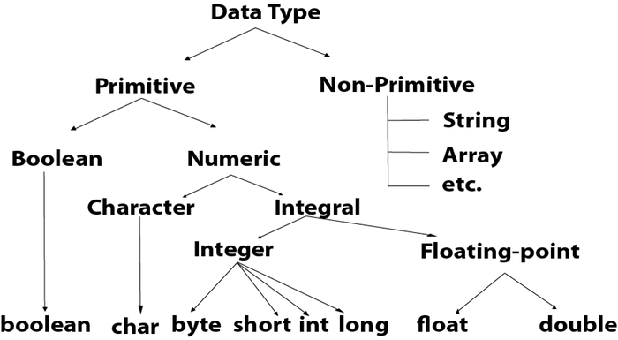
Java Primitive Data Types:
In Java language, primitive data types are the building blocks of data manipulation. These are the most basic data types available in Java language.

Slide 30
Data Type | Default Value | Default size
boolean | false | 1 bit
char | '\u0000' | 2 byte
byte | 0 | 1 byte
short | 0 | 2 byte
int | 0 | 4 byte
long | 0L | 8 byte
float | 0.0f | 4 byte
double | 0.0d | 8 byte

Slide 31
Boolean Data Type:
The Boolean data type is used to store only two possible values: true and false. This data type is used for simple flags that track true/false conditions.
The Boolean data type specifies one bit of information, but its "size" can't be defined precisely.
    Example:
    Boolean one = false
Byte Data Type:
The byte data type is an example of primitive data type. It isan 8-bit signed two's complement integer. Its value-range lies between -128 to 127 (inclusive). Its minimum value is -128 and maximum value is 127. Its default value is 0.
The byte data type is used to save memory in large arrays where the memory savings is most required. It saves space because a byte is 4 times smaller than an integer. It can also be used in place of "int" data type.
    Example:
    byte a = 10, byte b = -20

Slide 32
Short Data Type:
The short data type is a 16-bit signed two's complement integer. Its value-range lies between -32,768 to 32,767 (inclusive). Its minimum value is -32,768 and maximum value is 32,767. Its default value is 0.
The short data type can also be used to save memory just like byte data type. A short data type is 2 times smaller than an integer.
    Example:
    short s = 10000, short r = -5000
Int Data Type:
The int data type is a 32-bit signed two's complement integer. Its value-range lies between - 2,147,483,648 (-2^31) to 2,147,483,647 (2^31 -1) (inclusive). Its minimum value is - 2,147,483,648and maximum value is 2,147,483,647. Its default value is 0.
The int data type is generally used as a default data type for integral values unless if there is no problem about memory.
    Example:
    int a = 100000, int b = -200000

Slide 33
Long Data Type:
The long data type is a 64-bit two's complement integer. Its value-range lies between -9,223,372,036,854,775,808(-2^63) to 9,223,372,036,854,775,807(2^63 -1)(inclusive). Its minimum value is - 9,223,372,036,854,775,808and maximum value is 9,223,372,036,854,775,807. Its default value is 0. The long data type is used when you need a range of values more than those provided by int.
    Example:
    long a = 100000L, long b = -200000L
Float Data Type:
The float data type is a single-precision 32-bit IEEE 754 floating point.Its value range is unlimited. It is recommended to use a float (instead of double) if you need to save memory in large arrays of floating point numbers. The float data type should never be used for precise values, such as currency. Its default value is 0.0F.
    Example:
    float f1 = 234.5f

Slide 34
Double Data Type:
The double data type is a double-precision 64-bit IEEE 754 floating point. Its value range is unlimited. The double data type is generally used for decimal values just like float. The double data type also should never be used for precise values, such as currency. Its default value is 0.0d.
    Example:
    double d1 = 12.3
Char Data Type:
The char data type is a single 16-bit Unicode character. Its value-range lies between '\u0000' (or 0) to '\uffff' (or 65,535 inclusive).The char data type is used to store characters.
    Example:
    char letterA = 'A'

Slide 35
Basic Input/ Output
Java I/O (Input and Output) is used to process the input and produce the output.
Java uses the concept of a stream to make I/O operation fast. The java.io package contains all the classes required for input and output operations.
We can perform file handling in Java by Java I/O API.
Stream:
A stream is a sequence of data. In Java, a stream is composed of bytes. It's called a stream because it is like a stream of water that continues to flow.
In Java, 3 streams are created for us automatically. All these streams are attached with the console.
1) System.out: standard output stream
2) System.in: standard input stream
3) System.err: standard error stream

Slide 36
Operators and Expressions
Operator in Java is a symbol which is used to perform operations. For example: +, -, *, / etc.
There are many types of operators in Java which are given below:
    Unary Operator,
    Arithmetic Operator,
    Shift Operator,
    Relational Operator,
    Bitwise Operator,
    Logical Operator,
    Ternary Operator and
    Assignment Operator.

Slide 37
Java Operator Precedence
Operator Type | Category | Precedence
Unary | postfix | expr++ expr--
 | prefix | ++expr --expr +expr -expr ~ !
Arithmetic | multiplicative | * / %
 | additive | + -
Shift | shift | << >> >>>
Relational | comparison | < > <= >= instanceof
 | equality | == !=
Bitwise | bitwise AND | &
 | bitwise exclusive OR | ^
 | bitwise inclusive OR | |
Logical | logical AND | &&
 | logical OR | ||
Ternary | ternary | ? :
Assignment | assignment | = += -= *= /= %= &= ^= |= <<= >>= >>>=

Slide 38
Unary Operator:
The Java unary operators require only one operand. Unary operators are used to perform various operations i.e.:
incrementing/decrementing a value by one
negating an expression
inverting the value of a Boolean
Java Unary Operator Example: ++ and --
  class OperatorExample{
  public static void main(String args[]){
  int x=10;
  System.out.println(x++);//10 (11)
  System.out.println(++x);//12
  System.out.println(x--);//12 (11)
  System.out.println(--x);//10
  }
  }
Output:
10
12
12
10

Slide 39
Arithmetic Operators:
Java arithmatic operators are used to perform addition, subtraction, multiplication, and division. They act as basic mathematical operations.
Java Arithmetic Operator Example:
  class OperatorExample{
  public static void main(String args[]){
  int a=10;
  int b=5;
  System.out.println(a+b);//15
  System.out.println(a-b);//5
  System.out.println(a*b);//50
  System.out.println(a/b);//2
  System.out.println(a%b);//0
  }}
Output:
15
5
50
2
0

Slide 40
Java AND Operator Example: Logical && and Bitwise &:
The logical && operator doesn't check second condition if first condition is false. It checks second condition only if first one is true.
The bitwise & operator always checks both conditions whether first condition is true or false.
  class OperatorExample
  {
  public static void main(String args[]){
  int a=10;
  int b=5;
  int c=20;
  System.out.println(a<b&&a<c);//false && true = false
  System.out.println(a<b&a<c);//false & true = false
  }
  }
Output:
false
false

Slide 41
Java Ternary Operator:
Java Ternary operator is used as one liner replacement for if-then-else statement and used a lot in Java programming. it is the only conditional operator which takes three operands.
Java Ternary Operator Example:
  class OperatorExample
  {
  public static void main(String args[])
  {
  int a=2;
  int b=5;
  int min=(a<b)?a:b;
  System.out.println(min);
  }
  }
Output:
2

Slide 42
Assignment Operator:
Java assignment operator is one of the most common operator. It is used to assign the value on its right to the operand on its left.
Java Assignment Operator Example:
  class OperatorExample{
  public static void main(String args[]){
  int a=10;
  int b=20;
  a+=4;//a=a+4 (a=10+4)
  b-=4;//b=b-4 (b=20-4)
  System.out.println(a);
  System.out.println(b);
  }}
Output:
14
16

